Slide 1
Hungary: a proven location for Chinese investments Mr. Róbert Bödőcs Vice President

Slide 2
Hungary: Regional Center for Chinese Investments
Hungary has the biggest Chinese community within Central-Eastern Europe
China granted Approved Destination Status (ADS) to Hungary in 2002
Bilingual Chinese / Hungarian School in Budapest opened in 2004
Bank of China present in Budapest since 2003.
China Investment Promotion Agency, CIPA, MOFCOM set up its European Office in Budapest, February 2010
Notes:
Our mission
Implementation of foreign economic strategy and policy
Investment promotion, attracting foreign investors to Hungary, collecting investment projects
Supporting reinvestment of companies already settled in Hungary

Slide 3
advantages of business environment and geographical location of the country
Notes:
Our mission
Implementation of foreign economic strategy and policy
Investment promotion, attracting foreign investors to Hungary, collecting investment projects
Supporting reinvestment of companies already settled in Hungary

Slide 4
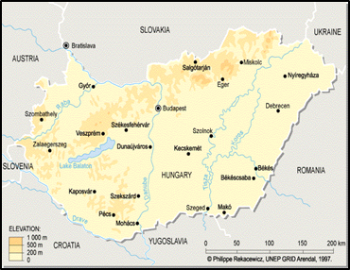
Proximity of European markets
Europe –
a common market of
507 million people in European Union
Close proximity to
143 million people in Russia
45 million people in Ukraine
20 million people in the Balkans
Hungary Land: 93,030 km²
Population: ~10 million
GDP/capita,
at PPP (2012):
EUR 16,800/
USD 22,924
Notes:
Our mission
Implementation of foreign economic strategy and policy
Investment promotion, attracting foreign investors to Hungary, collecting investment projects
Supporting reinvestment of companies already settled in Hungary

Slide 5
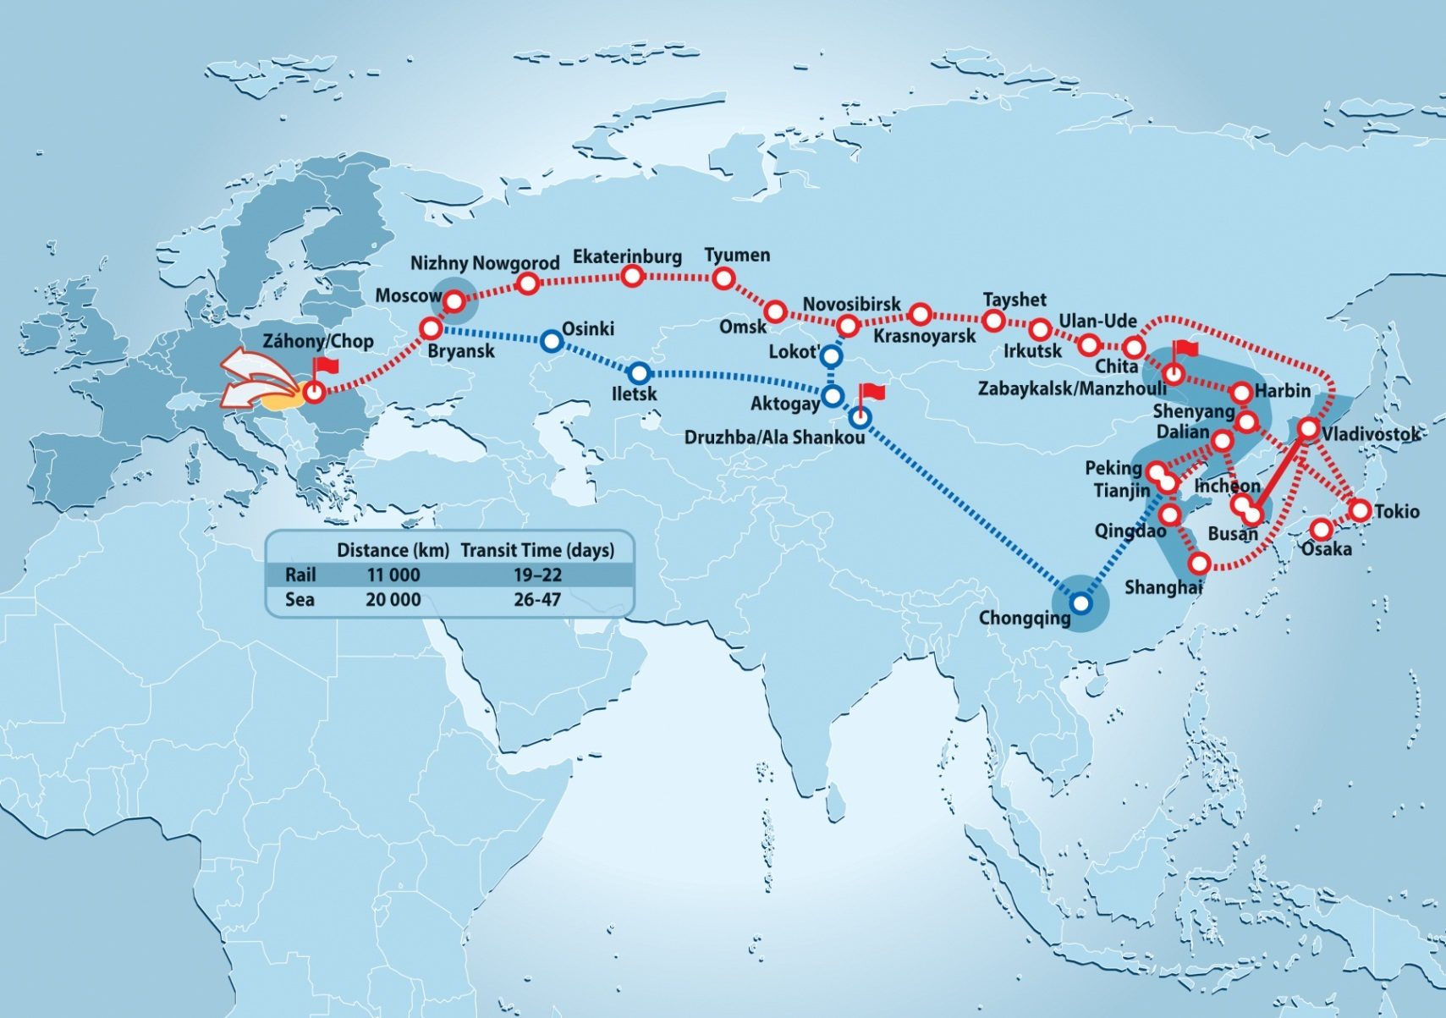
Railway transport connection between Far-East and Europe
Notes:
Our mission
Implementation of foreign economic strategy and policy
Investment promotion, attracting foreign investors to Hungary, collecting investment projects
Supporting reinvestment of companies already settled in Hungary

Slide 6
Take advantage from the European consumption habits
Source: IMD, 2012
Notes:
Our mission
Implementation of foreign economic strategy and policy
Investment promotion, attracting foreign investors to Hungary, collecting investment projects
Supporting reinvestment of companies already settled in Hungary

Slide 7
Key reasons to invest in Hungary
Well-qualified, cost effective and flexible labour force
Ideal location for distribution centers and for manufacturing activity
Extensive supplier background for the new coming investors
Highly developed logistical, transport and communication infrastructure
Ready-made industrial parks
Governmental incentives
Notes:
Our mission
Implementation of foreign economic strategy and policy
Investment promotion, attracting foreign investors to Hungary, collecting investment projects
Supporting reinvestment of companies already settled in Hungary

Slide 8
The most attractive city for investment
Rank | City | Country
1 | Budapest | Hungary
2 | Wroclaw | Poland
3 | Katowice | Poland
4 | Plzen | Czech Republic
5 | Moscow | Russia
6 | Brno | Czech Republic
7 | Poznan | Poland
8 | Ostrava | Czech Republic
9 | Bratislava | Slovakia
10 | Prague | Czech Republic
Budapest has been ranked the most attractive city in Eastern Europe in 2014-15.
Source: www.fDiIntelligence.com, European Cities and Regions of the Future 2014/15
Notes:
Our mission
Implementation of foreign economic strategy and policy
Investment promotion, attracting foreign investors to Hungary, collecting investment projects
Supporting reinvestment of companies already settled in Hungary

Slide 9
Sectors in focus
Notes:
Our mission
Implementation of foreign economic strategy and policy
Investment promotion, attracting foreign investors to Hungary, collecting investment projects
Supporting reinvestment of companies already settled in Hungary

Slide 10
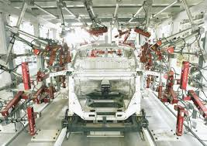
Major manufacturing industries in Hungary
Automotive
OEM’s: Daimler, Audi, Suzuki, Opel
TIER 1: 15 of the top 20 are present
The sector gives 21 percent of the total Hungarian export.
Electronics
Hungary is the largest electronics producer in Central and Eastern Europe
Success stories: Bosch, Huawei, Samsung, Infineon
Notes:
Our mission
Implementation of foreign economic strategy and policy
Investment promotion, attracting foreign investors to Hungary, collecting investment projects
Supporting reinvestment of companies already settled in Hungary

Slide 11
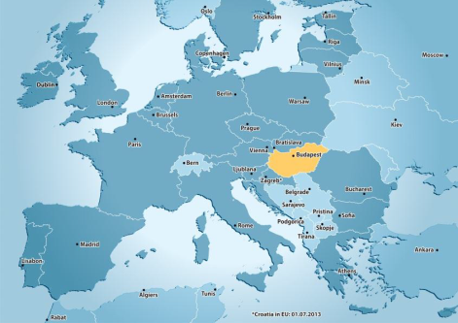
Major knowledge-based industries and service sectors in Hungary
Shared Service Centres
Booming sector with around 80 SSCs already operating in the country
Budapest is a proven location for SSCs
ICT
Outstanding cooperation between educational institutions and companies
Growing number of data centers
Life sciences
History of over 100 years in pharmaceutical manufacturing
Approximately 250 research and educational institutes related to biotech
Logistics
Strategic position in the heart of the continent
Highly developed transport infrastructure
Notes:
Our mission
Implementation of foreign economic strategy and policy
Investment promotion, attracting foreign investors to Hungary, collecting investment projects
Supporting reinvestment of companies already settled in Hungary

Slide 12
Food industry
Abundant raw material supply from high quality agricultural products
Food-processing sector is among the most modern in CEE with a significant foreign investment stock
126,000 people are employed in the Hungarian food sector – biggest within manufacturing industry
Excellent infrastructure for food storage and transportation
Major foreign investors: Nestlé, Unilever, Kraft Foods, CocaCola, Mars, Heineken, Bunge, Chio, Pepsico, Sara Lee, Kerry ingredients, Haribo, Nissin Foods
Notes:
Our mission
Implementation of foreign economic strategy and policy
Investment promotion, attracting foreign investors to Hungary, collecting investment projects
Supporting reinvestment of companies already settled in Hungary

Slide 13
Main positive decisions in 2014
Alumetal (30 m EUR; 150 jobs)
Apollo Tyres (475 m EUR;975 jobs)
Computacenter (220 jobs)
Ecosolifer (23,5 m EUR; 100 jobs)
Emirates (300 jobs)
GE SSC ( 53,90 m EUR; 1300 jobs)
Honeywell (10 m EUR; 109 jobs)
Nokia Networks (10 m EUR; 150 jobs)
Pactera(11,50 m EUR; 230 jobs)
Samsonite (8 m EUR; 110 jobs)
Notes:
Our mission
Implementation of foreign economic strategy and policy
Investment promotion, attracting foreign investors to Hungary, collecting investment projects
Supporting reinvestment of companies already settled in Hungary

Slide 14
Incentives
Notes:
Our mission
Implementation of foreign economic strategy and policy
Investment promotion, attracting foreign investors to Hungary, collecting investment projects
Supporting reinvestment of companies already settled in Hungary

Slide 15
Available Incentives
Cash grants
EU co-financed tenders
OR
Cash subsidy based on the decision of the Hungarian Government (EKD)
Development tax allowance
Social Tax Allowance
Training subsidy
Workshop establishment aid
Notes:
Our mission
Implementation of foreign economic strategy and policy
Investment promotion, attracting foreign investors to Hungary, collecting investment projects
Supporting reinvestment of companies already settled in Hungary

Slide 16
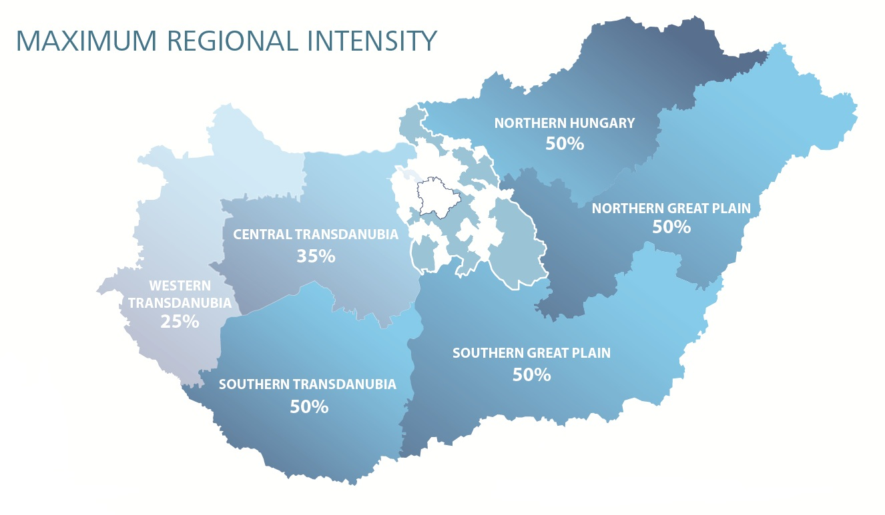
Regional Aid Intensity

Slide 17
Chinese Success Stories In Hungary
Notes:
Our mission
Implementation of foreign economic strategy and policy
Investment promotion, attracting foreign investors to Hungary, collecting investment projects
Supporting reinvestment of companies already settled in Hungary

Slide 18
Hungary as a top destination for Chinese tourists
China – CEE Touristic Regional Center has been founded in Budapest in 2014
Major tasks:
Develop relations between China and the CEE region
Create and share databases
Organize professional forums
Promote Hungary as a top destination for Chinese tourists
Notes:
Our mission
Implementation of foreign economic strategy and policy
Investment promotion, attracting foreign investors to Hungary, collecting investment projects
Supporting reinvestment of companies already settled in Hungary

Slide 19
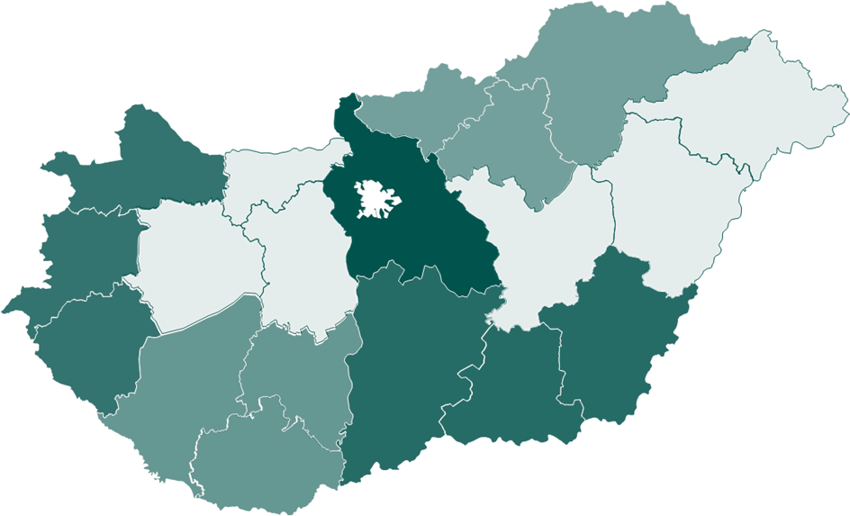
Major Chinese Investors who have already chosen Hungary
Notes:
Our mission
Implementation of foreign economic strategy and policy
Investment promotion, attracting foreign investors to Hungary, collecting investment projects
Supporting reinvestment of companies already settled in Hungary

Slide 20
Success story: the operation of Wanhua in Hungary
The acquisition was one of the biggest Chinese outbound investment deals in Europe in 2011
BorsodChem is a leading European producer of MDI, TDI, PVC today
BorsodChem is one of the largest industrial companies in Hungary
Notes:
Our mission
Implementation of foreign economic strategy and policy
Investment promotion, attracting foreign investors to Hungary, collecting investment projects
Supporting reinvestment of companies already settled in Hungary

Slide 21
Success story: the operation of Huawei in Hungary
2005 - establishment of the Hungarian office
2011 - production of telecommunication devices
for the entire European, Middle East and African
Region (in contract manufacturing with Flextronics
and Foxconn)
2012 - European logistics centre operated by DHL.
The logistics centre supplies Europe, North Africa,
the Middle East and Russia from Hungary
Notes:
Our mission
Implementation of foreign economic strategy and policy
Investment promotion, attracting foreign investors to Hungary, collecting investment projects
Supporting reinvestment of companies already settled in Hungary

Slide 22
Success story: the operation of ZTE in Hungary
2009 - establishment of the Hungarian office
main activity: maintenance of
telecommunication equipment
2010 - LTE technology infrastructure
development for Telenor
2012 - network operation centre
set up in Budapest to monitor
telecommunication networks
in the entire South-East European
region
Notes:
Our mission
Implementation of foreign economic strategy and policy
Investment promotion, attracting foreign investors to Hungary, collecting investment projects
Supporting reinvestment of companies already settled in Hungary

Slide 23
Governmental Strategic Agreements
Wanhua and the Hungarian Government
(chemical industry)
Huawei and the Hungarian Government
(electronics sector)
ZTE and and the Hungarian Government
(electronics sector)
Notes:
Our mission
Implementation of foreign economic strategy and policy
Investment promotion, attracting foreign investors to Hungary, collecting investment projects
Supporting reinvestment of companies already settled in Hungary

Slide 24
Services of HIPA
Notes:
Our mission
Implementation of foreign economic strategy and policy
Investment promotion, attracting foreign investors to Hungary, collecting investment projects
Supporting reinvestment of companies already settled in Hungary

Slide 25
Who we are?
Governmental agency
Main tasks: investment promotion and export development
Domestic and foreign network
Free of charge services
Notes:
Our mission
Implementation of foreign economic strategy and policy
Investment promotion, attracting foreign investors to Hungary, collecting investment projects
Supporting reinvestment of companies already settled in Hungary

Slide 26
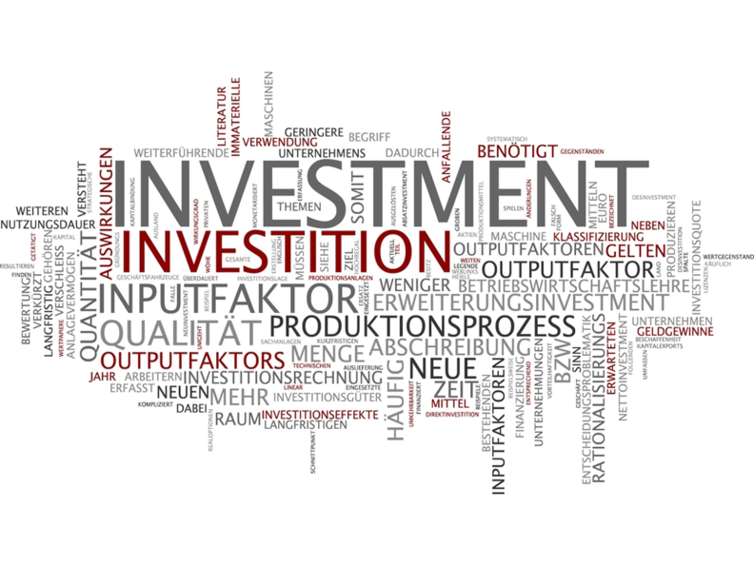
Our services
Project management
Supplier search
Incentives
Hungarian Investment Projects
Notes:
Our mission
Implementation of foreign economic strategy and policy
Investment promotion, attracting foreign investors to Hungary, collecting investment projects
Supporting reinvestment of companies already settled in Hungary

Slide 27
We are at your service locally
Beijing
peking@hipa.hu
Shanghai
shanghai@hipa.hu
Chongqing
chongqing@hipa.hu
Notes:
Our mission
Implementation of foreign economic strategy and policy
Investment promotion, attracting foreign investors to Hungary, collecting investment projects
Supporting reinvestment of companies already settled in Hungary

Slide 28
Mr. Róbert Bödőcs Vice President
robert.bodocs@hipa.hu

