Slide 1
Renminbi internationalisation – the Central Bank’s perspective
Szilárd Erhart
Budapest Renminbi Initiative
Central Bank of Hungary
26 March2015

Slide 2


Agenda
  Quick wrap of RMB internationalisation
  Central banks’ responsibilities and the MNB’s Renminbi Program

Slide 3

1. Background of RMB internationalisation
„crossing the river by feeling the stones”
Deng Xiaoping

Slide 4
The RMB internationalisation story in short
PAST: Current account liberalisation implemented – RMB is now a trading currency
PRESENT: Capital account liberalisation started – RMB may become an investment currency (QFI, RQFI, ODI, QDII, etc)
FUTURE: Exchange rate and interest rate liberalisation is on the way - RMB may become a reserve currency
You are here.

Slide 5
China’s share in global exports has jumped since its WTO membership in 2001
Share in global exports (%)
Source: WTO http://www.wto.org/english/res_e/statis_e/its2013_e/section1_e/i05.xls

Slide 6
RMB’s weight in payments and FX-market turnover is still low, but increased fast recently
Weight of selected currencies in payment and FX market turnover (2013)
Source: SWIFT, BIS

Slide 7
The RMB’s payment weight in European renminbi centers grew to 20-40 percent
Renminbi payments value weights
(international flows sent to and received directly from China and Hong Kong)
Source: SWIFT

Slide 8
Hong Kong is the most important RMB center, however London and Luxembourg are coming up
Source: PWC, SWIFT, Central Banks

Slide 9
Central banks are collaborating with market participants on the RMB internationalisation
Renminbi initiatives in Europe

Slide 10
  2. Central banks achievements, challenges and the MNB’s Renminbi Program
    Inter central bank swapline agreements
    RMB instruments
    Foreign reserve management
    Financial stability and supervisory issues
    Settlements and clearing

Slide 11
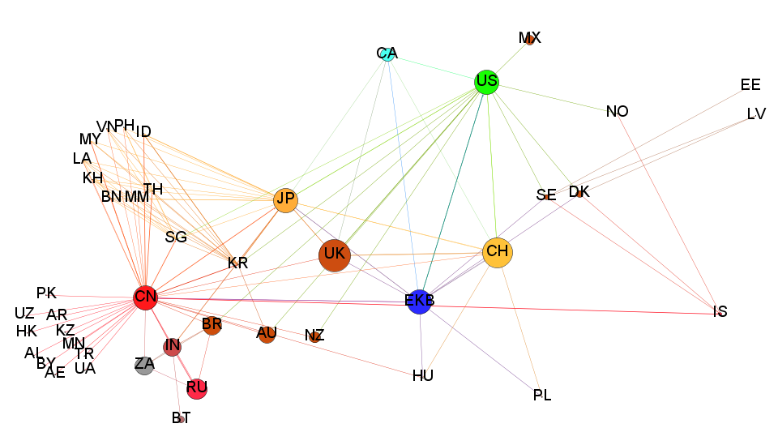
1. The PBOC’s network became the largest segment of the global inter central bank swapline network
The international swap line network structure*
The PBOC enlarged its network, while the ECB and FED did not
The main objectives of swap line agreements are to
  strengthen economic relations
  encourage bilateral trade and investment activity and
  maintain financial stability
FED (2009) – 14 partners
Network of the big 6
Chiang Mai initiative
BRICS (2014)
ECB (2010)
PBOC (2014) – 29 partners
*The chart was prepared with Gephi network viwualisation software on the basis of information from Allen and Moessner (2010)¹, Liao-McDowell (2013), PBoC and central banks.

Slide 12
The total valaue of PBOC swapline arrangements is over USD 400 bn
The Central Bank of Hungary followed the example of the ECB and BoE and joined the PBOC’s swapline network in 2013.
The PBOC carried out transactions amounting to RMB 511 billion (approx. USD 80 billion) in H1 2014.
Operational risk may occur as some central banks have not yet drawn renminbi funds at all, and all conditions of bilateral swapline transactions have not been finalised yet.

Slide 13
2. RMB instruments of central banks
Due to the limited convertibility in RMB offshore markets, central banks’ swapline network may serve financial stability purposes (liquidity backstop).
Main characteristics of central banks RMB instruments

Slide 14
3. RMB foreign reserves
“(…) central banks across the world have started to hold onshore Chinese renminbi (CNY) in their reserves portfolios, (…) This is an issue that the Eurosystem will also have to further reflect on in the future.”
Benoît Cœuré, ECB Executive Board member 17 November 2014
  Opportunities:
    Liquid market: onshore Chinese government bond market is the fifth-largest in the world
    yield: relatively high, and RMB appreciation magnified yields of unhedged positions in the past
    Diversification gains: by lowering market, credit and concentration risks
    Strong fundamentals: low debt ratio, high ratings
  Investor CBs: BOE, RBA, BDC, BON, BOK, etc
    Size of the RMB portfolio: 1-3 % of the total foreign reserves
    Quota: Central banks have been granted investment quotas since the first rounds of capital account liberalisation.
  Challenges:
    differences in legal norms,
    Implementation of investments (technical conditions, settlement, communication, onshore or offshore?)
    Transparency, follow-up and repatriation of investments

Slide 15
4. Financial stability and regulatory issues
CHALLENGES
BOE – risks to financial stability: capital account liberalisation can also be accompanied by risks to domestic and global financial stability Hooley, J. (2014)
MAS - liberalisation requires adequate sequencing:
  Risk of capital outflow if liberalisation of capital controls is prior to the liberalisation of interest rates
  interest rate liberalisation may add to the costs of banks, reduce profit rates
IMF, Eichengreen (2014) – further development of the institutional framework could be advantageous:
  establishment of deposit insurance and investment protection institutions,
  company information system and credit rating, independent central bank etc
Currency mismatch risks (FX lending experience in CEE countries)
  FX reserve adequacy may worsen in non-eurozone countries
  FX- Liquidity Coverage Ratio may deteriorate in RMB hubs
Regulatory arbitrage: Luxembourg used to be preferred to London due to Luxembourg’s more favourable supervisory practice
ANSWERS
regulatory limits on the scope of banking services to protect tax-payers
Monitoring of cross-border RMB activities
  Currency mismatch
  Capital flows
  Regulatory arbitrage
Continous development of the regulatory framework
Supervisory cooperation with Chinese authorities
  Establishment of information sharing practices (similarly to supervisory colleges)
  Revision of MoUs on supervisory issues
  Development of the institutional framework

Slide 16
5. Clearing and settlement issues
Details of Chinese clearing and settlement agreements
PBOC typically concluded memorandums of understanding (MoU) on clearing and settlement with its swapline partner central banks.
Official clearing banks:
  BoC – Bank of China
  CCB – China Construction Bank
  ICBC – Industrial and Commercial Bank of China
CIPS – China International Payment System is expected to be launched in September 2015 to process cross-border RMB transactions

Slide 17
The MNB’s Renminbi Program
Starting point: RMB swapline agreement (September 2013)
Budapest Renminbi Initiative (from March 2015)
FX reserve management
  Investigation whether a small portion of the foreign reserves could be invested in renminbi assets.
Clearing and settlement (from February 2015)
  Planning of the renminbi clearing and settlement infrastructure
  Memorandum of Understanding.
  Supporting the appointment of the official renminbi clearing bank.
RMB instruments (2015):
  Investigation whether renminbi liquidity instruments can/should be applied.
Financial stability and supervisory issues (2015):
  Investigation of the risks related to the increasing renminbi market activity and monitoring of Chinese credit institutions, especially with regards to cross-border activity and to risks stemming from contagion and imbalances of the Chinese financial system.
  Cooperation with Chinese supervisory authorities and strengthening of the supervisory coordination and information sharing procedures.

Slide 18
Thank you for your attentiaon!
谢谢

